Slide 1
Principles of Linear Pipelining

Slide 2
Principles of Linear Pipelining
In pipelining, we divide a task into set of subtasks.
The precedence relation of a set of subtasks {T₁, T₂,…, T_{k}} for a given task T implies that the same task T_{j} cannot start until some earlier task T_{i} finishes.
The interdependencies of all subtasks form the precedence graph.

Slide 3
Principles of Linear Pipelining
With a linear precedence relation, task T_{j} cannot start until earlier subtasks { T_{i}} for all (i < j) finish.
A linear pipeline can process subtasks with a linear precedence graph.

Slide 4
Principles of Linear Pipelining
A pipeline can process successive subtasks if
    Subtasks have linear precedence order
    Each subtasks take nearly same time to complete

Slide 5
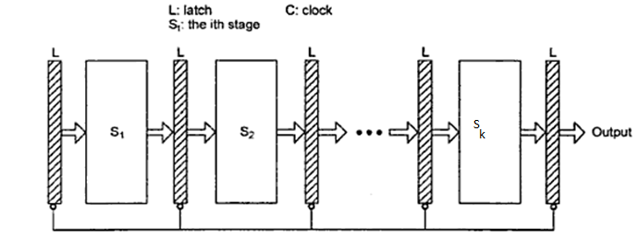
Basic Linear Pipeline
L: latches, interface between different stages of pipeline
S1, S2, etc. : pipeline stages

Slide 6
Basic Linear Pipeline
It consists of cascade of processing stages.
Stages : Pure combinational circuits performing arithmetic or logic operations over the data flowing through the pipe.
Stages are separated by high speed interface latches.
Latches : Fast Registers holding intermediate results between stages
Information Flow are under the control of common clock applied to all latches

Slide 7
Basic Linear Pipeline
L: latches, interface between different stages of pipeline
S1, S2, etc. : pipeline stages

Slide 8
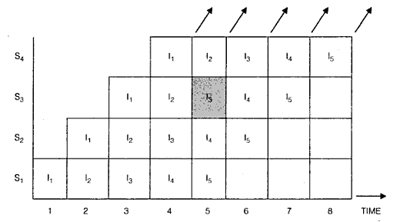
Basic Linear Pipeline
The flow of data in a linear pipeline having four stages for the evaluation of a function on five inputs is as shown below:

Slide 9
Basic Linear Pipeline
The vertical axis represents four stages
The horizontal axis represents time in units of clock period of the pipeline.

Slide 10
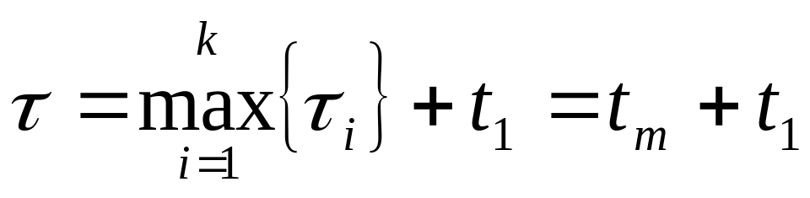
Clock Period (τ) for the pipeline
Let τ_{i} be the time delay of the circuitry S_{i} and t₁ be time delay of latch.
Then the clock period of a linear pipeline is defined by
The reciprocal of clock period is called clock frequency (f = 1/τ) of a pipeline processor.

Slide 11
Performance of a linear pipeline
Consider a linear pipeline with k stages.
Let T be the clock period and the pipeline is initially empty.
Starting at any time, let us feed n inputs and wait till the results come out of the pipeline.
First input takes k periods and the remaining (n-1) inputs come one after the another in successive clock periods.
Thus the computation time for the pipeline T_{p} is
T_{p} = kT+(n-1)T = [k+(n-1)]T

Slide 12
Performance of a linear pipeline
For example if the linear pipeline have four stages with five inputs.
Tp = [k+(n-1)]T = [4+4]T = 8T

Slide 13
Example : Floating Point Adder Unit

Slide 14
Floating Point Adder Unit
This pipeline is linearly constructed with 4 functional stages.
The inputs to this pipeline are two normalized floating point numbers of the form
A = a x 2^{p}
B = b x 2^{q}
where a and b are two fractions and p and q are their exponents.
For simplicity, base 2 is assumed

Slide 15
Floating Point Adder Unit
Our purpose is to compute the sum
C = A + B = c x 2^{r} = d x 2^{s}
where r = max(p,q) and 0.5 ≤ d < 1
For example:
A=0.9504 x 10³
B=0.8200 x 10²
a = 0.9504 b= 0.8200
p=3 & q =2

Slide 16
Floating Point Adder Unit
Operations performed in the four pipeline stages are :
Compare p and q and choose the largest exponent, r = max(p,q)and compute t = |p – q|
Example:
r = max(p , q) = 3
t = |p-q| = |3-2|= 1

Slide 17
Floating Point Adder Unit
Shift right the fraction associated with the smaller exponent by t units to equalize the two exponents before fraction addition.
Example:
Smaller exponent, b= 0.8200
Shift right b by 1 unit is 0.082

Slide 18
Floating Point Adder Unit
Perform fixed-point addition of two fractions to produce the intermediate sum fraction c, where 0 ≤ c < 1
Example :
a = 0.9504 b= 0.082
c = a + b = 0.9504 + 0.082 = 1.0324

Slide 19
Floating Point Adder Unit
Count the number of leading zeros (u) in fraction c and shift left c by u units to produce the normalized fraction sum d = c x 2^{u}, with a leading bit 1. Update the large exponent s by subtracting s = r – u to produce the output exponent.
Example:
c = 1.0324 , u = -1 ➔ right shift
d = 0.10324 , s= r – u = 3-(-1) = 4
C = 0.10324 x 10⁴

Slide 20
Floating Point Adder Unit
The above 4 steps can all be implemented with combinational logic circuits and the 4 stages are:
Comparator / Subtractor
Shifter
Fixed Point Adder
Normalizer (leading zero counter and shifter)

Slide 21
4-STAGE FLOATING POINT ADDER
p
q
A = a x 2
B = b x 2
a
b
A
B
Stages:
Exponent
Other
Fraction
S1
subtractor
fraction
selector
r = max(p,q)
Fraction with min(p,q)
t = |p - q|
Right shifter
S2
Fraction
adder
r
c
Leading zero
S3
counter
c
Left shifter
r
d
Exponent
S4
adder
s
d
C= X + Y = d x 2^{s}

Slide 22
Example for floating-point adder
Exponents
Mantissas
a
b
A
B
R
R
Difference=3-2=1
Compare
exponents
by subtraction
For example:
X=0.9504*10³
Y=0.8200*10²
Segment 1:
R
Align mantissas
0.082
Segment 2:
Choose exponent
3
R
Add
mantissas
S=0.9504+0.082=1.0324
Segment 3:
R
R
Adjust
exponent
4
Normalize
result
Segment 4:
0.10324
R
R

Slide 23
Performance Parameters
The various performance parameters of pipeline are :
Speed-up
Throughput
Efficiency

Slide 24
Speedup
Speedup is defined as
Speedup = Time taken for a given computation by a non-pipelined functional unit
Time taken for the same computation by a pipelined version
Assume a function of k stages of equal complexity which takes the same amount of time T.
Non-pipelined function will take kT time for one input.
Then Speedup = nkT/(k+n-1)T = nk/(k+n-1)

Slide 25
Speed-up
For e.g., if a pipeline has 4 stages and 5 inputs, its speedup factor is
Speedup = ?

Slide 26
Efficiency
It is an indicator of how efficiently the resources of the pipeline are used.
If a stage is available during a clock period, then its availability becomes the unit of resource.
Efficiency can be defined as

Slide 27
Efficiency

Slide 28
Efficiency
No. of stage time units = nk
  there are n inputs and each input uses k stages.
Total no. of stage-time units available = k[ k + (n-1)]
  It is the product of no. of stages in the pipeline (k) and no. of clock periods taken for computation(k+(n-1)).

Slide 29
Throughput
It is the average number of results computed per unit time.
For n inputs, a k-staged pipeline takes [k+(n-1)]T time units
Then,
Throughput = n / [k+n-1] T = nf / [k+n-1]
where f is the clock frequency
  Throughput = Efficiency x Frequency

Slide 30
Point no 2
Classification of Pipelining

Slide 31
Handler’s Classification
Based on the level of processing, the pipelined processors can be classified as:
Arithmetic Pipelining
Instruction Pipelining
Processor Pipelining

Slide 32
Arithmetic Pipelining
The arithmetic logic units of a computer can be segmented for pipelined operations in various data formats.
Example : Star 100

Slide 33
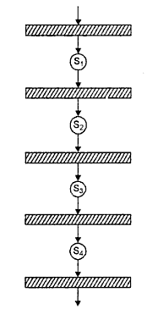
Arithmetic Pipelining

Slide 34
Instruction Pipelining
The execution of a stream of instructions can be pipelined by overlapping the execution of current instruction with the fetch, decode and operand fetch of the subsequent instructions
It is also called instruction look-ahead

Slide 35
Processor Pipelining
This refers to the processing of same data stream by a cascade of processors each of which processes a specific task
The data stream passes the first processor with results stored in a memory block which is also accessible by the second processor
The second processor then passes the refined results to the third and so on.

Slide 36
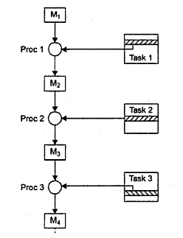
Processor Pipelining

Slide 37
Li and Ramamurthy's Classification
According to pipeline configurations and control strategies, Li and Ramamurthy classify pipelines under three schemes
  Unifunction v/s Multi-function Pipelines
  Static v/s Dynamic Pipelines
  Scalar v/s Vector Pipelines

Slide 38
Uni-function v/s Multi-function Pipelines

Slide 39
Unifunctional Pipelines
A pipeline unit with fixed and dedicated function is called unifunctional.
Example: CRAY1 (Supercomputer - 1976)
It has 12 unifunctional pipelines described in four groups:
  Address Functional Units:
    Address Add Unit
    Address Multiply Unit

Slide 40
Unifunctional Pipelines
  Scalar Functional Units
    Scalar Add Unit
    Scalar Shift Unit
    Scalar Logical Unit
    Population/Leading Zero Count Unit
  Vector Functional Units
    Vector Add Unit
    Vector Shift Unit
    Vector Logical Unit

Slide 41
Unifunctional Pipelines
  Floating Point Functional Units
    Floating Point Add Unit
    Floating Point Multiply Unit
    Reciprocal Approximation Unit

Slide 42
Multifunctional
A multifunction pipe may perform different functions either at different times or same time, by interconnecting different subset of stages in pipeline.
Example 4X-TI-ASC (Supercomputer - 1973)

Slide 43
Static Vs Dynamic Pipeline

Slide 44
Static Pipeline
It may assume only one functional configuration at a time
Static pipelines are preferred when instructions of same type are to be executed continuously
A unifunction pipe must be static.

Slide 45
Dynamic pipeline
It permits several functional configurations to exist simultaneously
A dynamic pipeline must be multi-functional
The dynamic configuration requires more elaborate control and sequencing mechanisms than static pipelining

Slide 46
Scalar Vs Vector Pipeline

Slide 47
Scalar Pipeline
It processes a sequence of scalar operands under the control of a DO loop
Instructions in a small DO loop are often prefetched into the instruction buffer.
The required scalar operands are moved into a data cache to continuously supply the pipeline with operands
Example: IBM System/360 Model 91

Slide 48
Vector Pipelines
They are specially designed to handle vector instructions over vector operands.
Computers having vector instructions are called vector processors.
The design of a vector pipeline is expanded from that of a scalar pipeline.
The handling of vector operands in vector pipelines is under firmware and hardware control.
Example : Cray 1

